Slide 1
Relational Data Model
Lecture 02

Slide 2
Database
The Database Properties :
Centralized repository
Real-time
Concurrent
Interactive (ad-hoc) query

Slide 3
Why DBMSs?
Some of the advantages of Database Management systems:
Data administration
Efficient data access
Data integrity & security
Concurrent access, crash recovery

Slide 4
Data Models
Data modeling simply is a method of describing data or information.
It includes:
Structure of data
In what format data is stored
Operations on Data
Selection
Set of queries to fetch the data
Modification
Operations to modify the database and the data
Constraints
It defines what data can be stored in the database by enforcing rules and limitations

Slide 5
Why Relational Data Model?
It provides both
Efficient data access
By structuring data
Efficient data manipulation
By providing set of operations

Slide 6
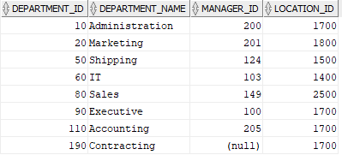
Relational Data Model Basics
The relational model represents data as a two dimensional.
In the relational model, a table is also called a relation.
In the following table
Every row represent a department.
Every column in a row, represent an attribute of that department.
department

Slide 7
Attributes
Columns in a table (relation) are called attributes.
In the following table (department), the attributes are:
Department_id
Department_name
Manager_id
Location_id
department

Slide 8
Schema
A schema represent the name of a relation and its attributes.
DEPARTMENT(department_id,department_name, manager_id,Location_id)
A relational database consists of a set of relations(tables).
A relational database schema is a set of schemas of database relations.

Slide 9
Tuple
In a relation (table), a row (record) is called a tuple.
The following relation (department) has 8 tuples.
The value of each attribute in a tuple represents a component.
department

Slide 10
Domains
In a relational model, each components of a tuple must be atomic. Each component is allowed to be a single value of primitive types (integer, character, character string).
The domain of an attribute (column) is simply the data type of that attribute.
DEPARTMENT(department_id,department_name, manager_id ,Location_id)

Slide 11
Default Value
You can specify a default value for a column.
A default value is the value to be inserted into a column if no other value is specified.
If not explicitly specified, the default value of a column is NULL.

Slide 12
Null Value
Null denotes the absent of a value.
The value of an attribute is null if
It is unknown
It does not exist

Slide 13
Integrity Constraints
Integrity constraints are a set of rules to maintain the quality.
Domain/tuple constraints
Entity integrity constraints
Key constraints
Referential integrity constraints

Slide 14
Domain Integrity Constraint
To restrict the values of tuple attributes in a database relation.
Domain constraints
Define conditions on a single attribute of a tuple
department_id = 60
Tuple constraints
Define conditions on different attributes of a tuple
department_id = 60 and location_id =1700

Slide 15
Constraints
Constraints are used to ensure that the database receives “good” data
PRIMARY KEY
unique and not null
NOT NULL
a value must exist
UNIQUE
value exists only once in a column
CHECK
value must pass validation criteria
FOREIGN KEY
used to enforce Relational Integrity between two tables

Slide 16
Primary Key Constraint
A primary key, in a relation(table), identifies every tuple(row) uniquely.
A primary key can be a single attribute or a set of attributes.
In a multi-attribute primary key, the combinations of key attributes must be unique for each row in the table.
In table department, the key is department_id which is unique for every row.
To represent primary key in a table, key attributes are underlined.
DEPARTMENT(department_id, department_name, manager_id, Location_id)

Slide 17
Entity Integrity Constraint
This constraint ensures that each table has a primary key.
A primary key is an attribute or set of attributes that uniquely identifies every row in a table.
The values of the attributes involved in the primary key cannot be null.
Attribute department_id is the primary key of table department.
DEPARTMENT (department_id,department_name, manager_id,Location_id)
A primary key is unique and cannot be null.

Slide 18
Referential integrity Constraint
Referential integrity is a constraint specified on two tables.
Referential integrity constraint determines if two tables are related. A value appearing in a column of a table also appears in a column of another table.
Location ID exits in tables department and locations.
Attribute location_id in table department refers to the location_id attribute in table locations.
DEPARTMENT(department_id,department_name, manager_id,Location_id)
LOCATIONS(location_id,street_address,postal_code,city,state_province,country_id)

Slide 19
Relationships
When multiple tables, or entities, are being used, there is often attributes in each table the relates the two tables together.
Relationship Types
There are three types of relationships:
. 1-to-many (1:M)
. 1-to-1 (1:1)
. many-to-many (M:M)

Slide 20
Foreign Key Constraint
The Foreign Key enforces relational integrity between the two tables.
The Foreign Key is used to create 1:M relationships between two tables. It is used to get information from another table using the primary key of that table.
The table with the foreign key column is the child table.
The table that is referred by the foreign key column in the CHILD table is the PARENT table.

Slide 21
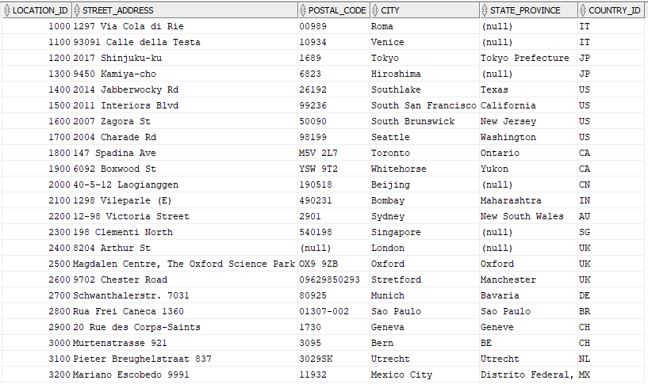
Referential Integrity Constraints
departments
locations

